Slide 1
Overview of Serial Bus Protocols
Frank Walsh

Slide 2
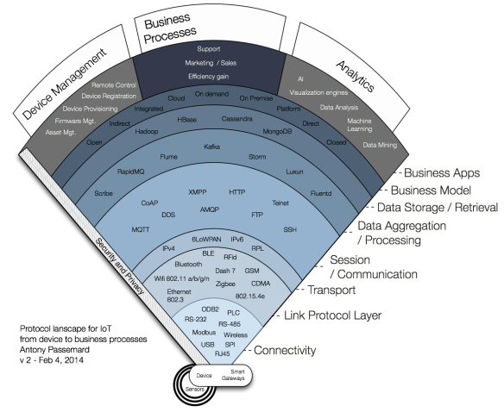
We’re focussing around here…

Slide 3
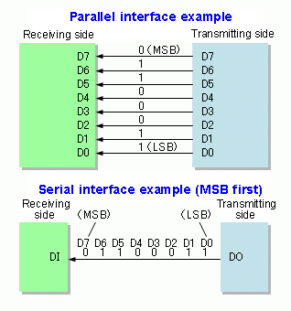
Serial Bus
A communication system that transfers data between components inside a computer or between computers
Generally 2 types
Parallel
Serial
Parallel is simplest to implement but takes up a lot of hardware ‘real estate’
Serial requires fewer lines to transmit data but this adds complexity.
Synchronous – uses clock
Asynchronous – no clock but speed (baud rate) agreed before transmission.

Slide 4
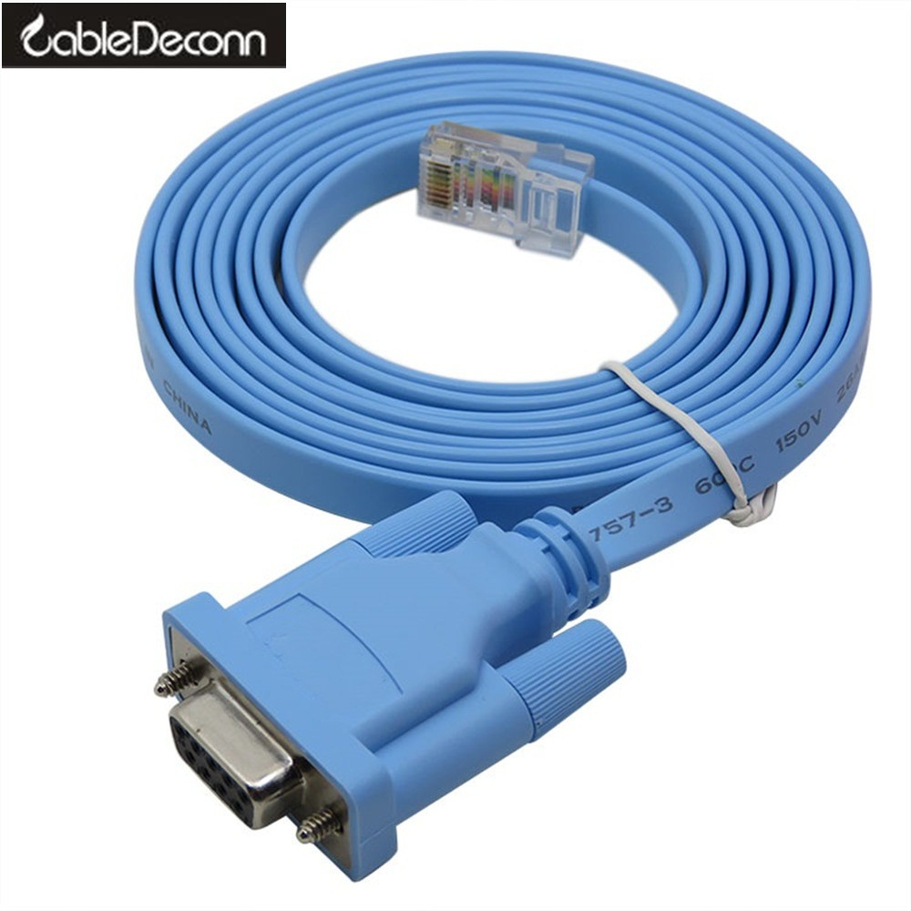
Asynchronous Serial (RS232)
Used for 1-to-1 communication
Many variants, simplest just uses 2 lines.
Often used for console access to configure Network Routers

Slide 5
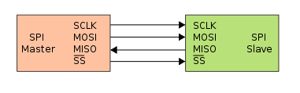
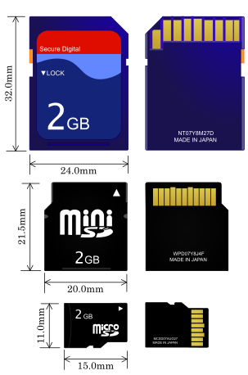
Serial Peripheral Interface (SPI)
Master and Slave Devices
One master and multiple slaves
Used in liquid crystal displays and SD Cards
Master set the speed
Signals
SCLK: Serial Clock (output from master).
MOSI: Master Output Slave Input, or Master Out Slave In (data output from master).
MISO: Master Input Slave Output, or Master In Slave Out (data output from slave).
SS: Slave Select (pulling line low selects slave, output from master).

Slide 6
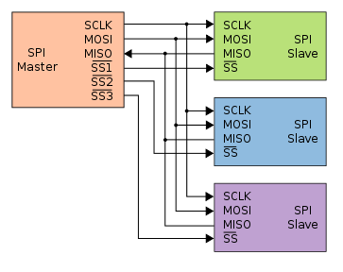
Serial Peripheral Interface (SPI)
Slave select line goes low to select slave
Full duplex data transmission occurs.
The master sends a bit on the MOSI line and the slave reads it
The slave sends a bit on the MISO line and the master reads it.

Slide 7

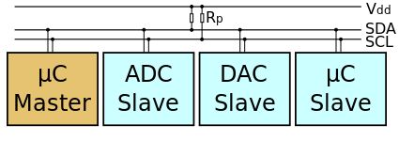
I²C (Inter-Integrated Circuit)
Also referred to as 2-wire bus.
Clock(SCL) and Data(SDL)
Used for connecting lower-speed devices to processors and microcontrollers
Master-slave approach.
Unlike SPI, uses addressing instead of physical Slave Select lines (hence only 2 wires).
Speeds: 100kbs, 400kbs, 1Mbs and 3.4Mbs

Slide 8
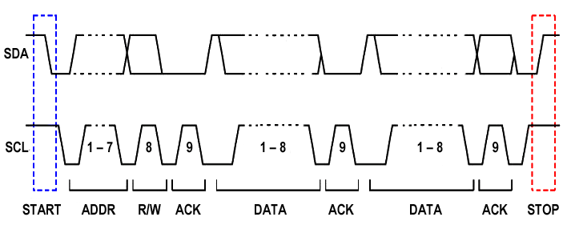
I²C (Inter-Integrated Circuit)
SDA,SLC start high
Master: SDA to low to signal start
Master: Send SCL with 7 bit address followed by 0 (for write)
Slave: pulls SDA to low for Acknowledgement
Master: sends 8 bit data on SDA
Slave: Acknowledgement
All: allow SDA, whin SCL is high to Stop

Slide 9
I²C (Inter-Integrated Circuit)
You can transfer multiple bytes consecutively

Slide 10
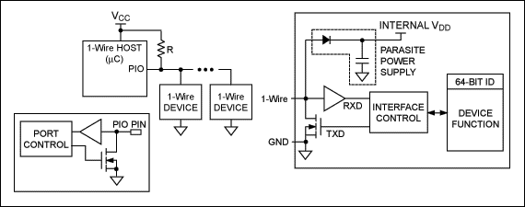
1-Wire
provides low-speed data, signaling, and power over a single wire.
Similar to I²C, but lower data rates and longer range.
Despite the name, you need 2 wires:
Data and ground.
Because there’s no power(Vcc line), 1-Wire devices use capacitors to store power
Parasitic device – takes power from bus.
power the device when the data line is active

Slide 11
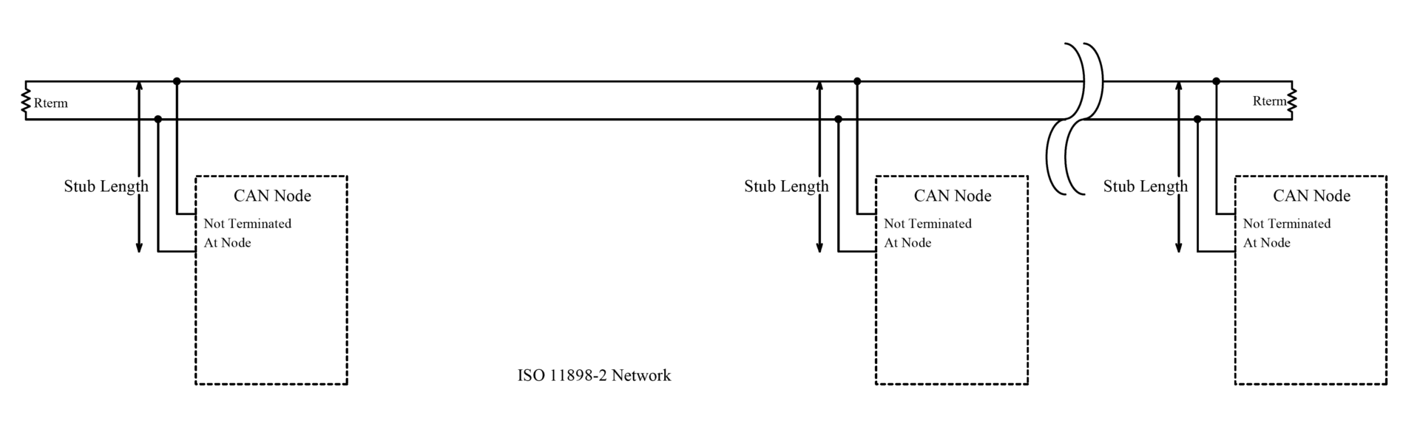
CAN (Controller Area Network)
A Controller Area Network (CAN bus) allows microcontrollers and devices to communicate with each other.
Predominantly used in Automotive
Also in aviation/industrial
No Master-Slave, it’s mutli-master
Any node can initiate comms.
All nodes are connected to each other through a two wire bus

Slide 12
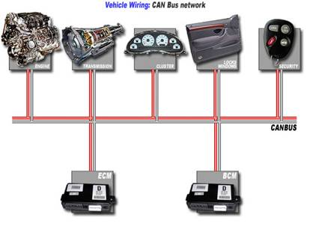
CAN (Controller Area Network)
CAN reduces wiring requirements
Robust protocol with built in fault tolerance
Reliable
That’s why it’s the defacto protocol in automotive
Relatively straight forward protocol to understand….

Slide 13

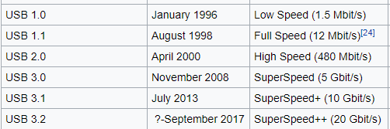
Universal Serial Bus (USB)
USB resulted from mixture of connection methods used on PCs
Serial ports (modems)
Parallel ports (printers)
PCI (keyboards and Mice)
Now it’s “defacto”
Low speed
Mice, keyboards
Full speed
Other devices
High speed
USB 2.0, media devices
USB 3.0…
Used for all sorts of stuff!!!

